Slide 1
Exam 4: Bodies
Chapters 9, 10, & 11
Rotation, Equilibrium, Stress & Strain

Slide 2
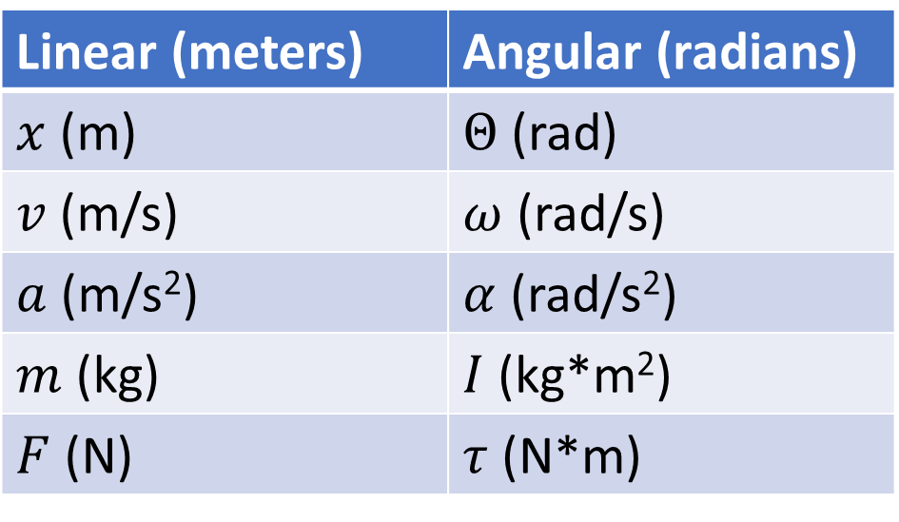
Chapter 9 – Angular Coordinates
Linear (meters) | Angular (radians)
$x$ (m) | $Θ$ (rad)
$v$ (m/s) | $ω$ (rad/s)
$a$ (m/s²) | $α$ (rad/s²)
$m$ (kg) | $I$ (kg*m²)
$F$ (N) | $τ$ (N*m)

Slide 3
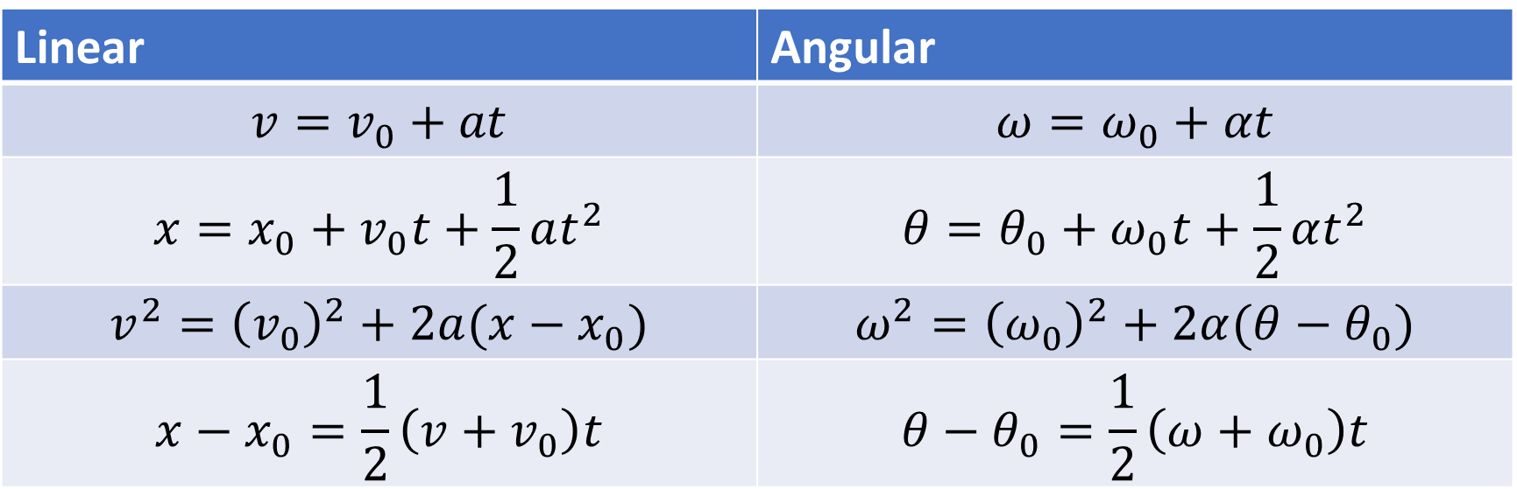
Chapter 9 – Angular Kinematics
Linear | Angular
$$v=v_{0}+at$$ | $$ω=ω_{0}+αt$$
$$x=x_{0}+v_{0}t+\frac{1}{2}at^{2}$$ | $$θ=θ_{0}+ω_{0}t+\frac{1}{2}αt^{2}$$
$$v^{2}={\left(v_{0}\right)}^{2}+2a(x−x_{0})$$ | $$ω^{2}={\left(ω_{0}\right)}^{2}+2α(θ−θ_{0})$$
$$x−x_{0}=\frac{1}{2}\left(v+v_{0}\right)t$$ | $$θ−θ_{0}=\frac{1}{2}\left(ω+ω_{0}\right)t$$

Slide 4

Chapter 9 – Converting Between Linear and Angular
$v=rω$
$a_{tan}=rα$
$a_{rad}=\frac{v^{2}}{r}=rω^{2}$

Slide 5
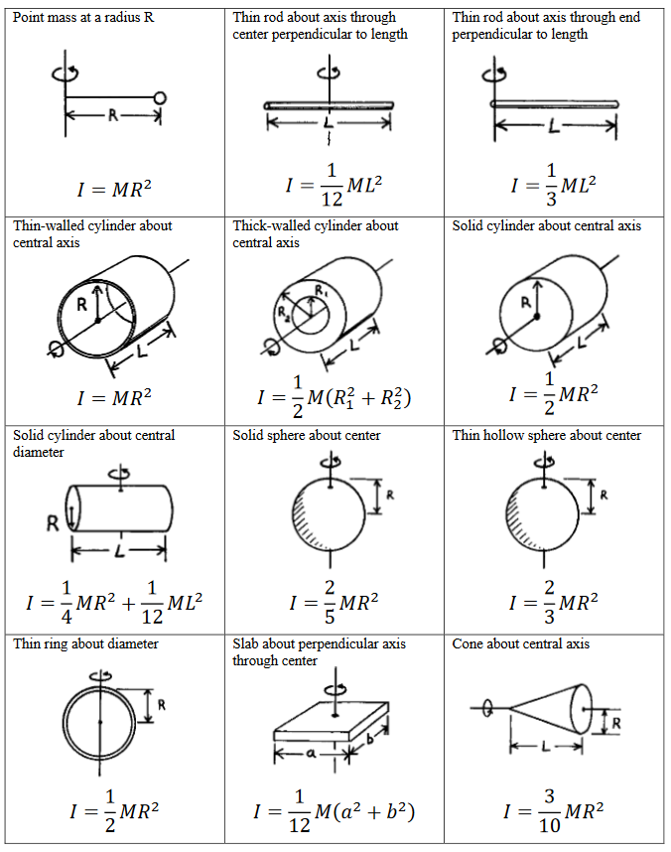

Chapter 9: Moment of Inertia
$I=m_{1}r_{1}^{2}+m_{2}r_{2}^{2}+ . . .$
Parallel axis theorem: $I_{p}=I_{cm}+md^{2}$

Slide 6
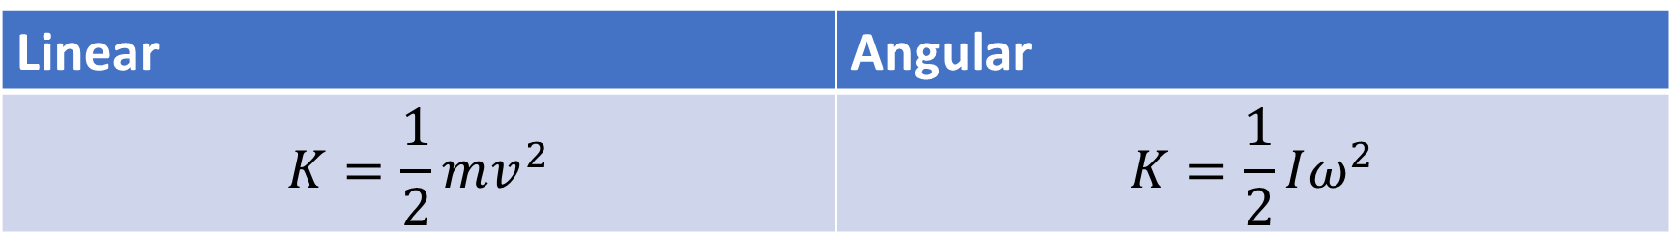
Chapter 9 – Rotational Kinetic Energy
Linear | Angular
$$K=\frac{1}{2}mv^{2}$$ | $$K=\frac{1}{2}Iω^{2}$$

Slide 7
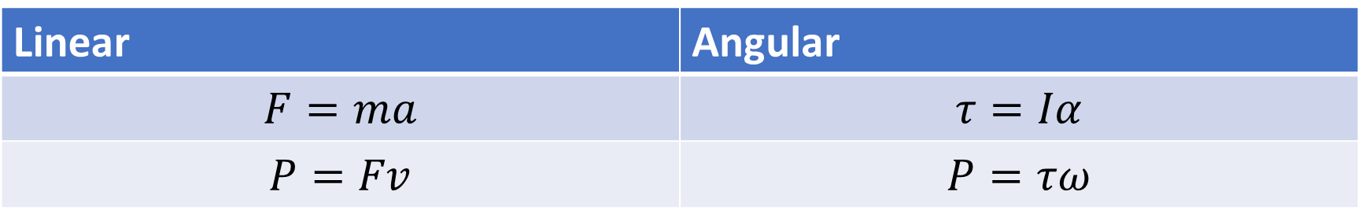

Chapter 10 - Torque
Torque = Force * LeverArm
$\overset{⃑}{τ}=\overset{⃑}{r}×\overset{⃑}{F}$
Linear | Angular
$$F=ma$$ | $$τ=Iα$$
$$P=Fv$$ | $$P=τω$$

Slide 8
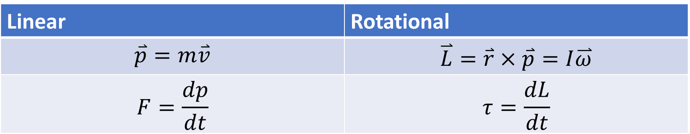
Chapter 10 – Angular Momentum
Linear | Rotational
$$\overset{⃑}{p}=m\overset{⃑}{v}$$ | $$\overset{⃑}{L}=\overset{⃑}{r}×\overset{⃑}{p}=I\overset{⃑}{ω}$$
$$F=\frac{dp}{dt}$$ | $$τ=\frac{dL}{dt}$$

Slide 9
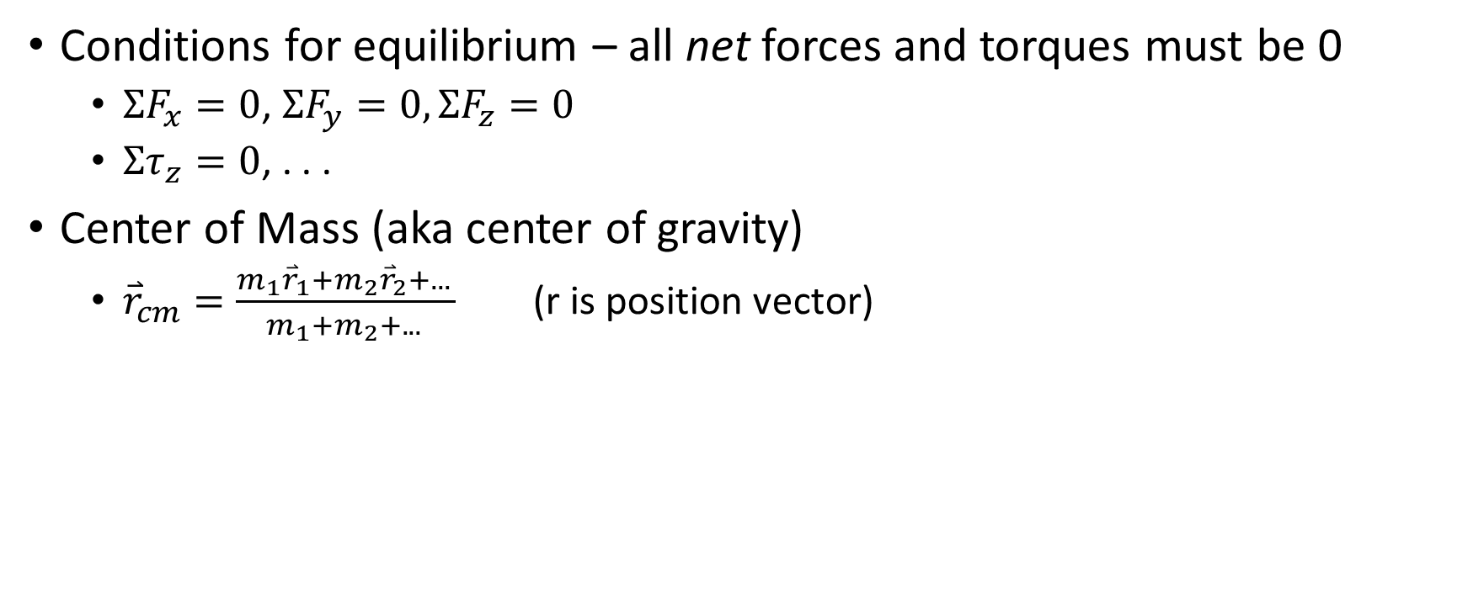
Chapter 11 – Equilibrium
Conditions for equilibrium – all net forces and torques must be 0
$ΣF_{x}=0$, $ΣF_{y}=0,ΣF_{z}=0$
$Στ_{z}=0$, . . .
Center of Mass (aka center of gravity)
${\overset{⃑}{r}}_{cm}=\frac{m_{1}{\overset{⃑}{r}}_{1}+m_{2}{\overset{⃑}{r}}_{2}+. . . }{m_{1}+m_{2}+. . . }$ (r is position vector)

Slide 10
Chapter 11 – Stress and Strain
Stress = Pressure = Force/Area
Strain = Deformation = change in length / original length
Elastic Modulus = Stress/Strain

Slide 11
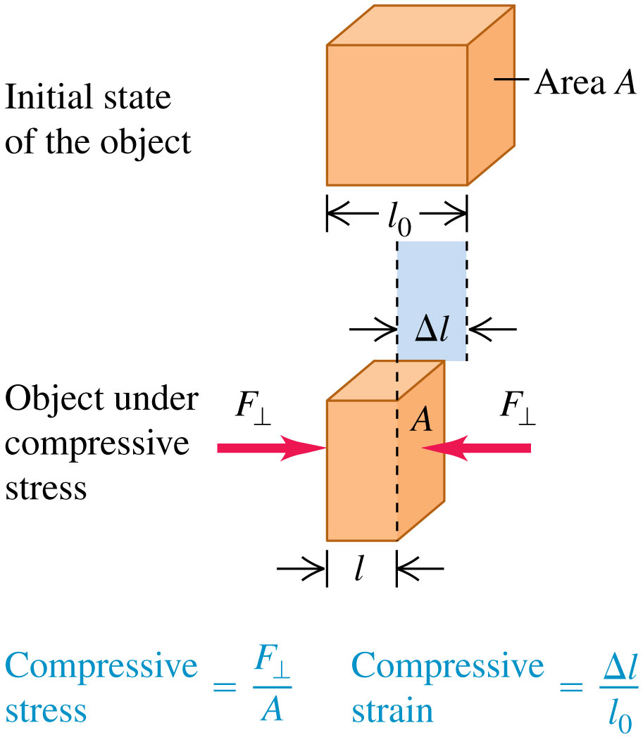
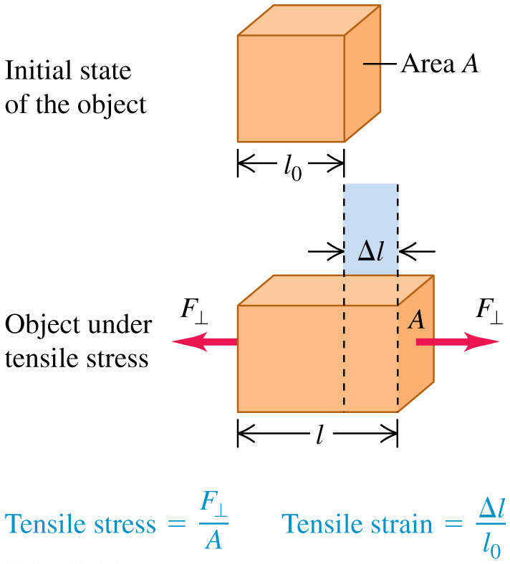
Tensile Stress and Strain

Slide 12
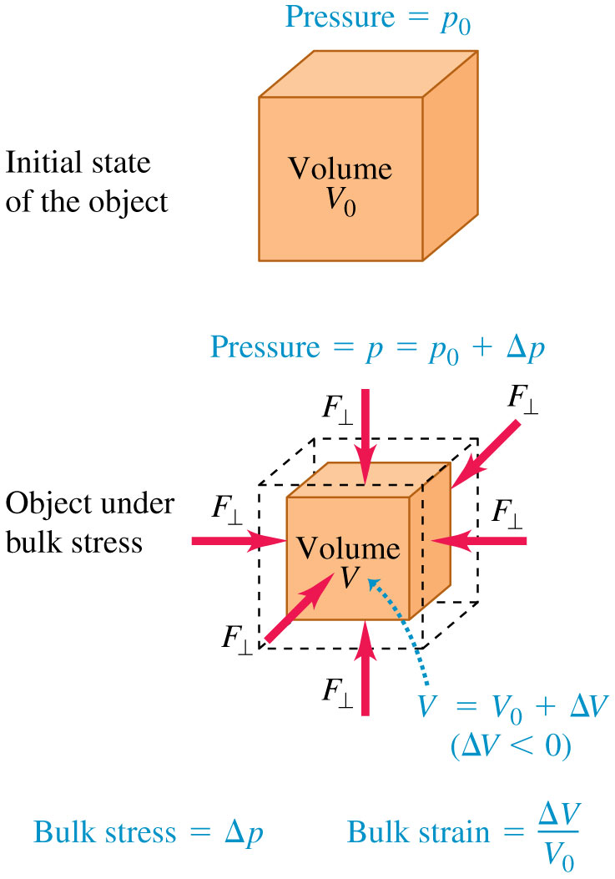
Chapter 11 – Bulk Stress and Strain
Bulk is from all sides (ie volume)
Bulk stress = change in pressure
Bulk strain = change in volume / original volume
Bulk modulus is still stress / strain

Slide 13
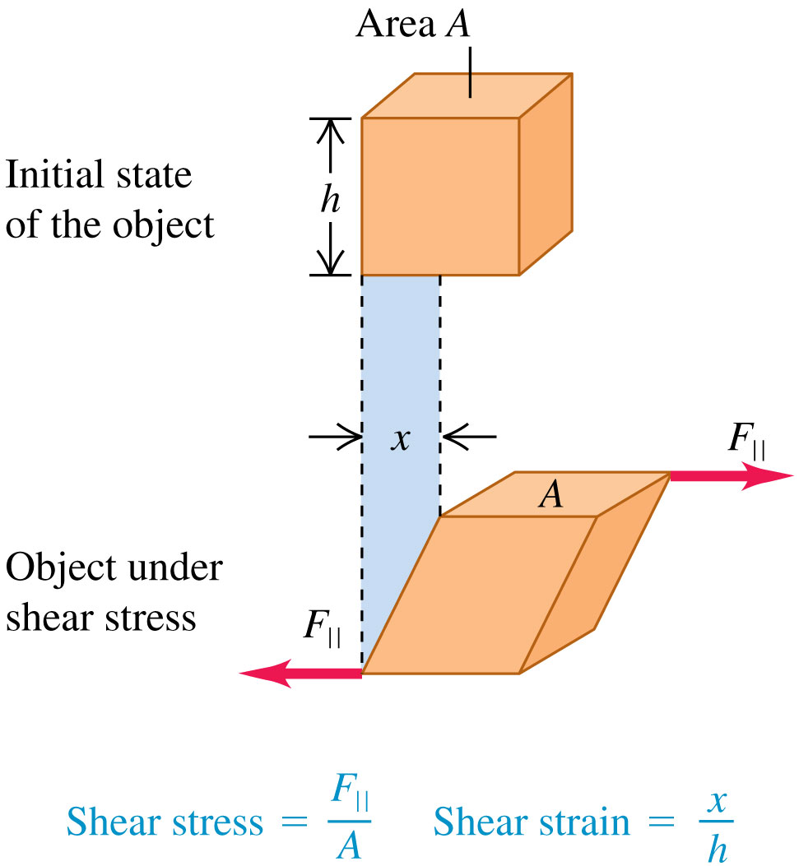
Chapter 11 – Sheer Stress and Strain
Stress = F / A
Strain = x / h

